Slide 1
The Impact of Different Factors on Student Academic Performance
Group 1
Kawthar Isa
Maryam Thani
Eman A.Redha

Slide 2
Problem Statement
To understand the influence of the parent's background, test preparation and gender on students’ performance

Slide 3
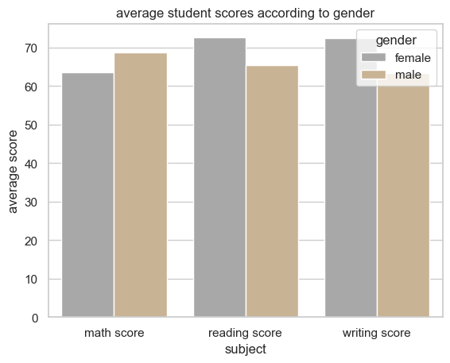
Gender Influence On Test Results
There is no significant difference between genders according to the overlap showing in the graph

Slide 4
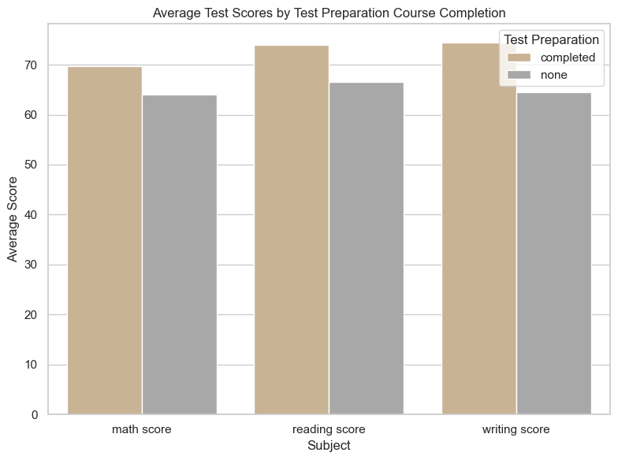
Test Preparation Course Influence On Test Results
There is no significant difference according to the overlap showing in the graph

Slide 5
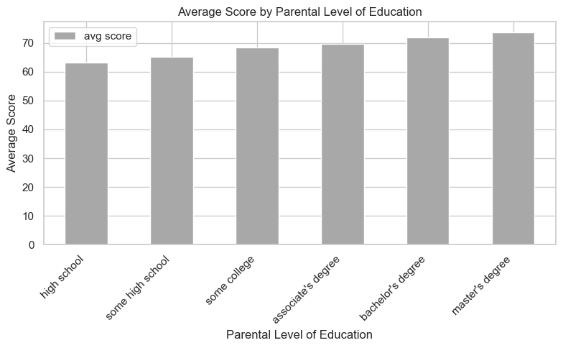
Parental Level of Education Influence On Test Results
The higher parental educational level the higher student academic achievement

Slide 6
Recommendation
Enhance Test Preparation Course
Promote Parental Involvement in Education.
Implement Continuous Monitoring and Feedback

Slide 7
THANK YOU

